Slide 1


SMART INDIA HACKATHON 2026
Problem Statement ID – SIH26083
Problem Statement Title- Extreme Heatwave Early Warning and Human Thermal Stress Index
Theme- Disaster Management
PS Category- Software
Team ID- SIH26-A0H-T275
Team Name - Tech Indians

Slide 2
El Niño-Aware AI Platform for Anticipatory Heatwave Risk, Human Thermal Stress and Localized Heat Action Planning
💡 Our Solution
Fuses climate drivers (El Nino/ENSO, IOD, SST, rainfall & soil-moisture anomalies) + district weather + WBGT thermal stress + vulnerability + response capacity into one anticipatory heat-risk platform.
✨ The Uniqueness
A novel district-level Indian platform combining ENSO/IOD climate intelligence + heatwave precursor detection + WBGT risk fusion + AI action optimizer + digital-twin what-if simulation.
🚨 The Problem
Moves beyond temperature-only, short-range alerts: adds climate-scale precursors, vulnerability-aware risk levels and AI action recommendations, not just a Red Alert.
🚀3–5 Day Anticipatory Heat-Risk Alerts
Integrates demographic vulnerability and environmental heat-stress indicators to estimate potential healthcare-surge risk and trigger localized Heat Action Plans through automated alerts.

Slide 3
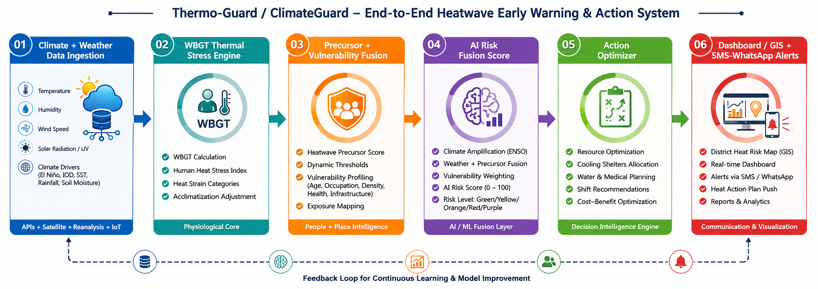
TECHNICAL APPROACH
💡 Technologies to be Used
Python (FastAPI), Pandas/NumPy/GeoPandas, Scikit-learn; PostgreSQL + PostGIS; Streamlit/React dashboard; Open-Meteo & IMD weather APIs; NOAA ENSO/SST indices + BoM IOD index; SMS/WhatsApp alert API
✨ Methodology and Process implementation - Pipeline shown below: data to alert in six stages

Slide 4
FEASIBILITY AND VIABILITY
💡 Feasibility of the idea
Core layer (Open-Meteo/IMD ingestion, WBGT calculation, dashboard, SMS/WhatsApp alerts) is fully feasible using free public APIs.
Climate-driver indices are publicly available and incorporated according to their respective update frequencies using cached and quality-controlled values.
✨ Challenges and risks
Data gaps/delays; short-range forecast uncertainty; false alarms reducing trust; limited public healthcare-outcome data; risk of over-attribution of local heatwaves to El Niño.
🛡️ Strategic Solutions
Multi-source data + caching + quality checks; confidence score shown with every alert; historical back-testing; categorical health-surge output until validated data exists; probabilistic climate language.

Slide 5
IMPACT AND BENEFITS
💡 Impact on the targeted audience
District disaster management authorities
Municipal bodies and hospitals
Outdoor workers, elderly, children and other vulnerable groups.
General public in heatwave-prone districts
✨ Benefits of the solution
Social: Earlier warning can support timely interventions for vulnerable groups and help reduce heat-related illness and adverse health outcomes.
Economic: lowers avoidable healthcare surge cost, protects outdoor-labour productivity, optimizes shelter/water/medical deployment
Governance: strengthens NDMA and state Heat Action Plans with data-driven, anticipatory response

Slide 6
RESEARCH AND REFERENCES
Reference and research work
India Meteorological Department (IMD): https://mausam.imd.gov.in
Open-Meteo Weather API: https://open-meteo.com
NOAA Climate Prediction Center - ONI/ENSO Index: https://origin.cpc.ncep.noaa.gov/products/analysis_monitoring/ensostuff/ONI_v5.php
Bureau of Meteorology, Australia - Indian Ocean Dipole Index: http://www.bom.gov.au/climate/enso/indices.shtml
WHO/WMO Heat-Health Action Plan Guidance
NDMA - National Guidelines for Management of Heat Waves

